Slide 1
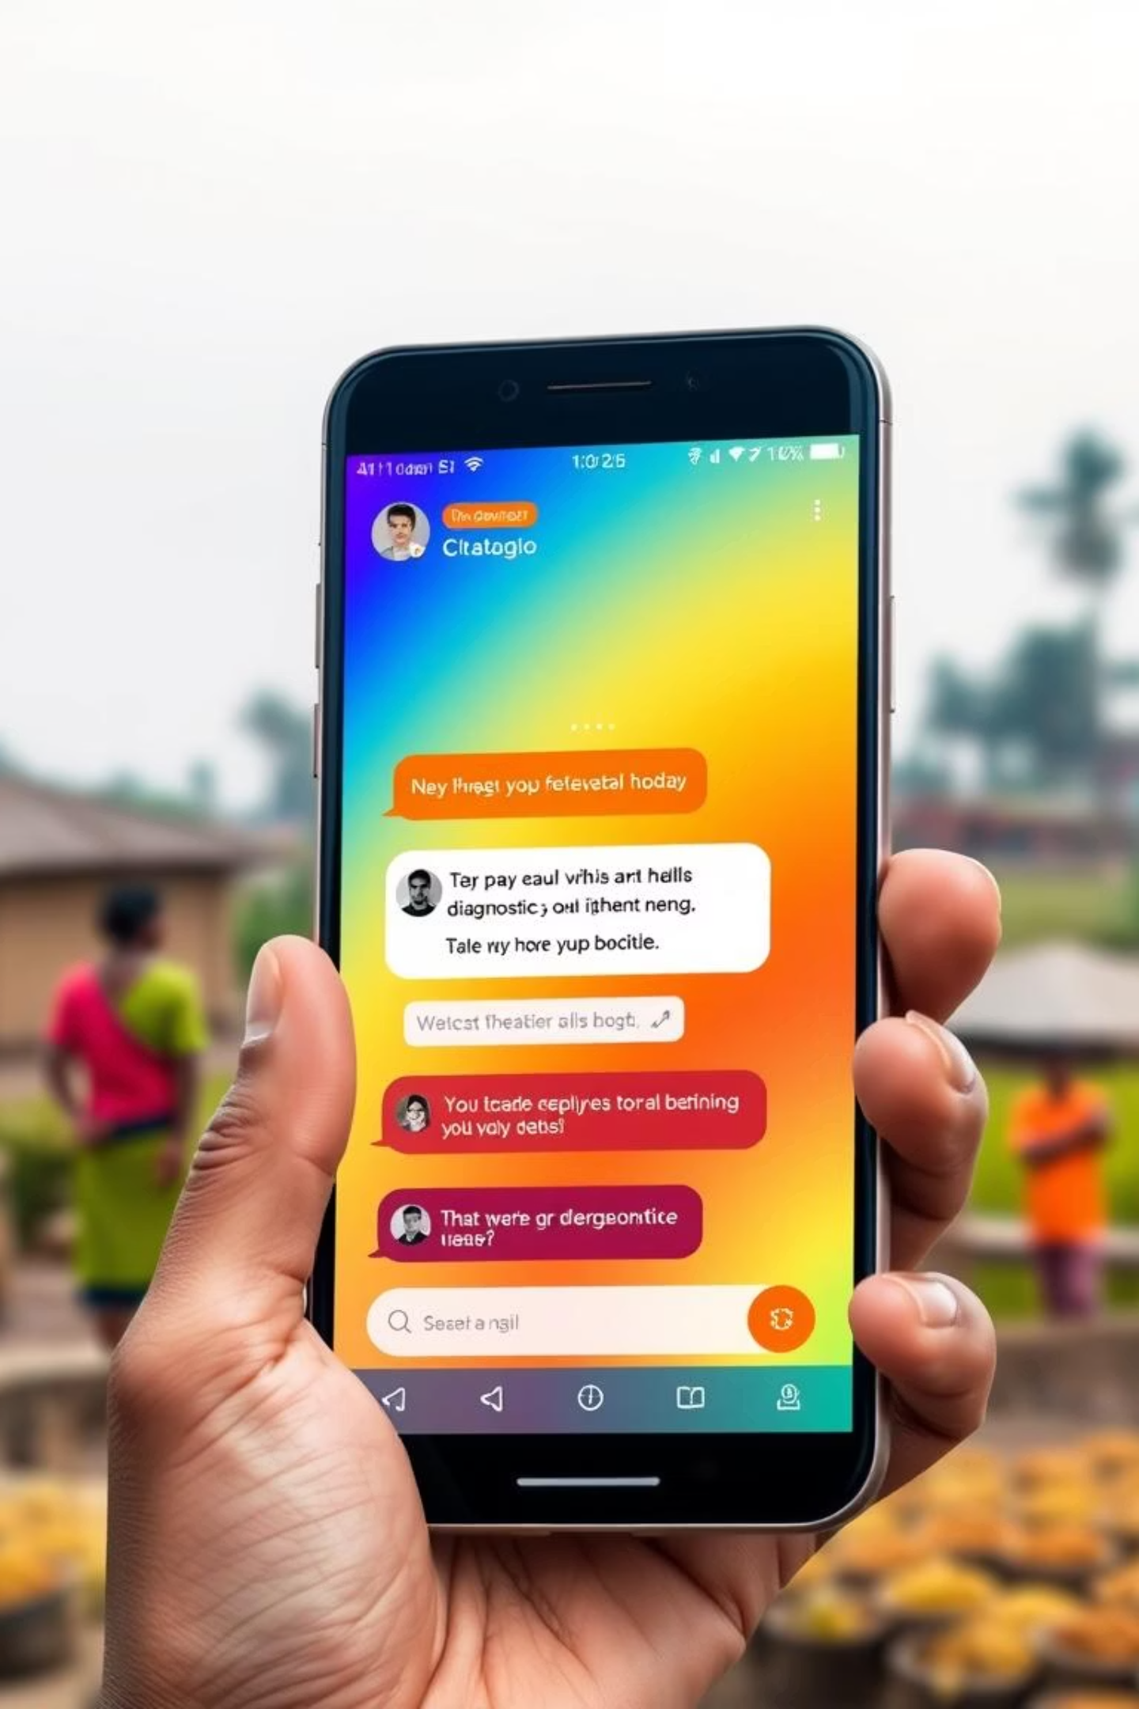
LEARNATHON 4.0
SwasthyaBot:
AI-Powered Diagnostic Chatbot for Rural Healthcare Accessibility
TEAM_16 MEMBERS:
………………………………………………………………… RAJDEEP PATNAIK
ABINASH PANDA
ARPIT PRADHAN
ANMOL SAHU

Slide 2
Index
Problem Statement
Introduction
Core Objectives
Simplified, multilingual, interactive user interface
Accurate AI-driven initial diagnosis and reporting
Integration of referral mechanisms for specialized medical care
Accessible via basic mobile devices for broad reach
Identify the problem
Identify the stakeholders

Slide 3
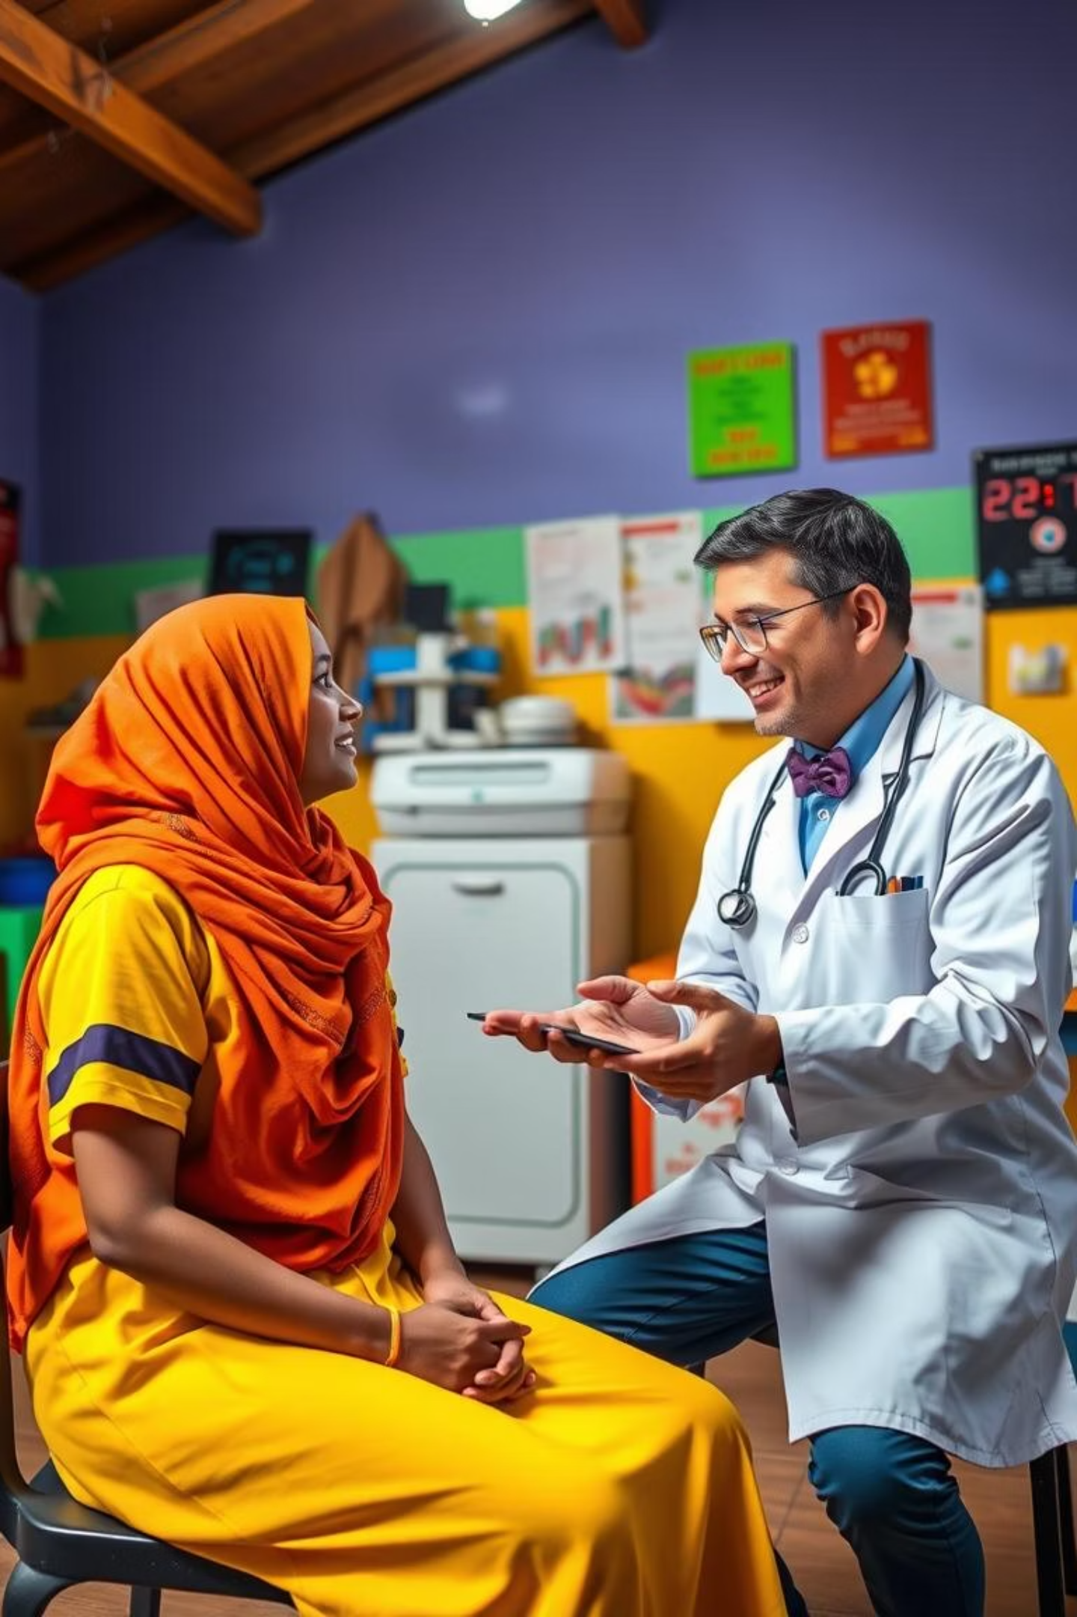
Introduction
In rural areas, timely healthcare access is limited, impacting the quality of medical interventions. This presentation outlines the design of an accessible, AI-driven chatbot platform (voice or text-based) that interactively assesses basic health symptoms, categorizes potential health issues, generates detailed preliminary diagnostic reports, and provides referrals to qualified medical practitioners in nearby urban centers.

Slide 4




Core Objectives
Simplified, multilingual, interactive user interface
Accurate AI-driven initial diagnosis and reporting
Integration of referral mechanisms for specialized medical care
Accessible via basic mobile devices for broad reach

Slide 5
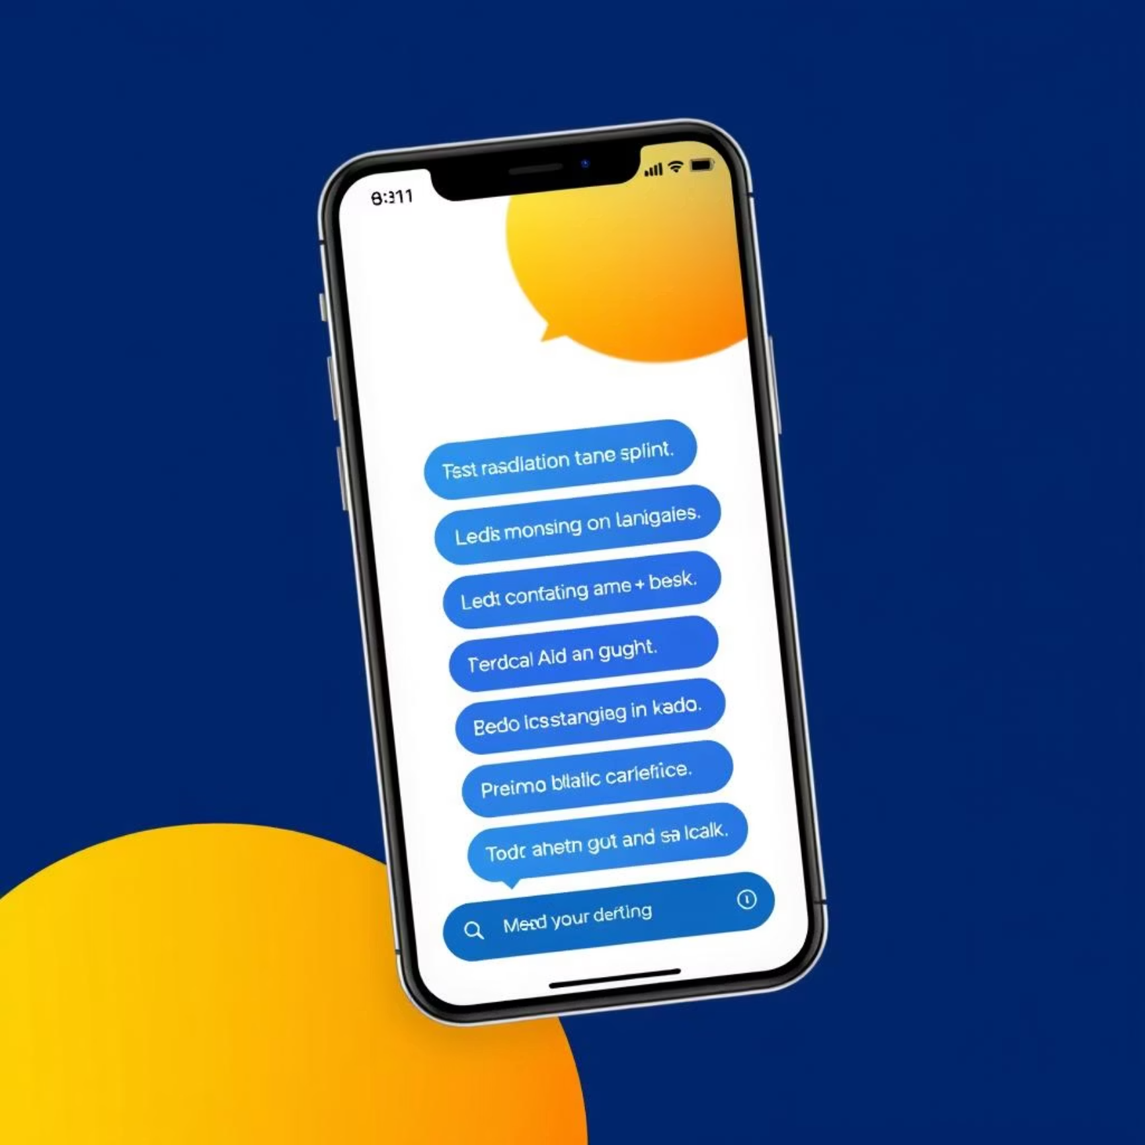
Simplified, Multilingual, Interactive User Interface
The chatbot platform will
feature a user-friendly
interface designed for ease of
use, even for individuals with
limited technological literacy.
It will support multiple
languages to cater to diverse
linguistic backgrounds
prevalent in rural India,
ensuring that language is not
a barrier to accessing
healthcare information.
The interactive nature of the interface, whether voice or text-based, will guide users through symptom assessment questions, making the process intuitive and engaging.

Slide 6
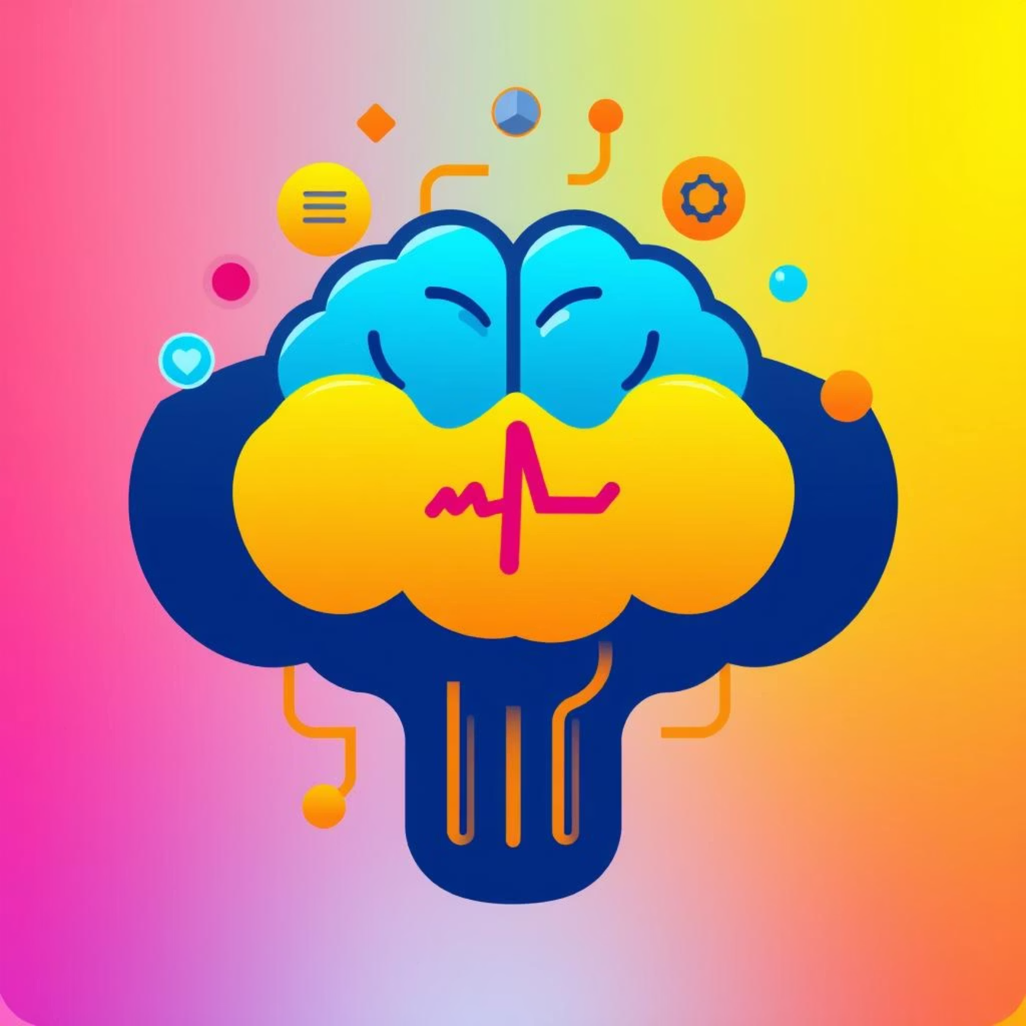
Accurate AI-Driven Initial Diagnosis and Reporting
Leveraging advanced AI
algorithms, the chatbot will
accurately assess basic health
symptoms provided by the
user. It will categorize
potential health issues based
on the input, providing a
preliminary diagnosis. The
platform will then generate
detailed diagnostic reports,
which can be shared with
medical professionals for
further consultation.
This AI-driven approach aims to provide reliable initial health assessments, reducing the burden on limited healthcare resources in rural areas.

Slide 7
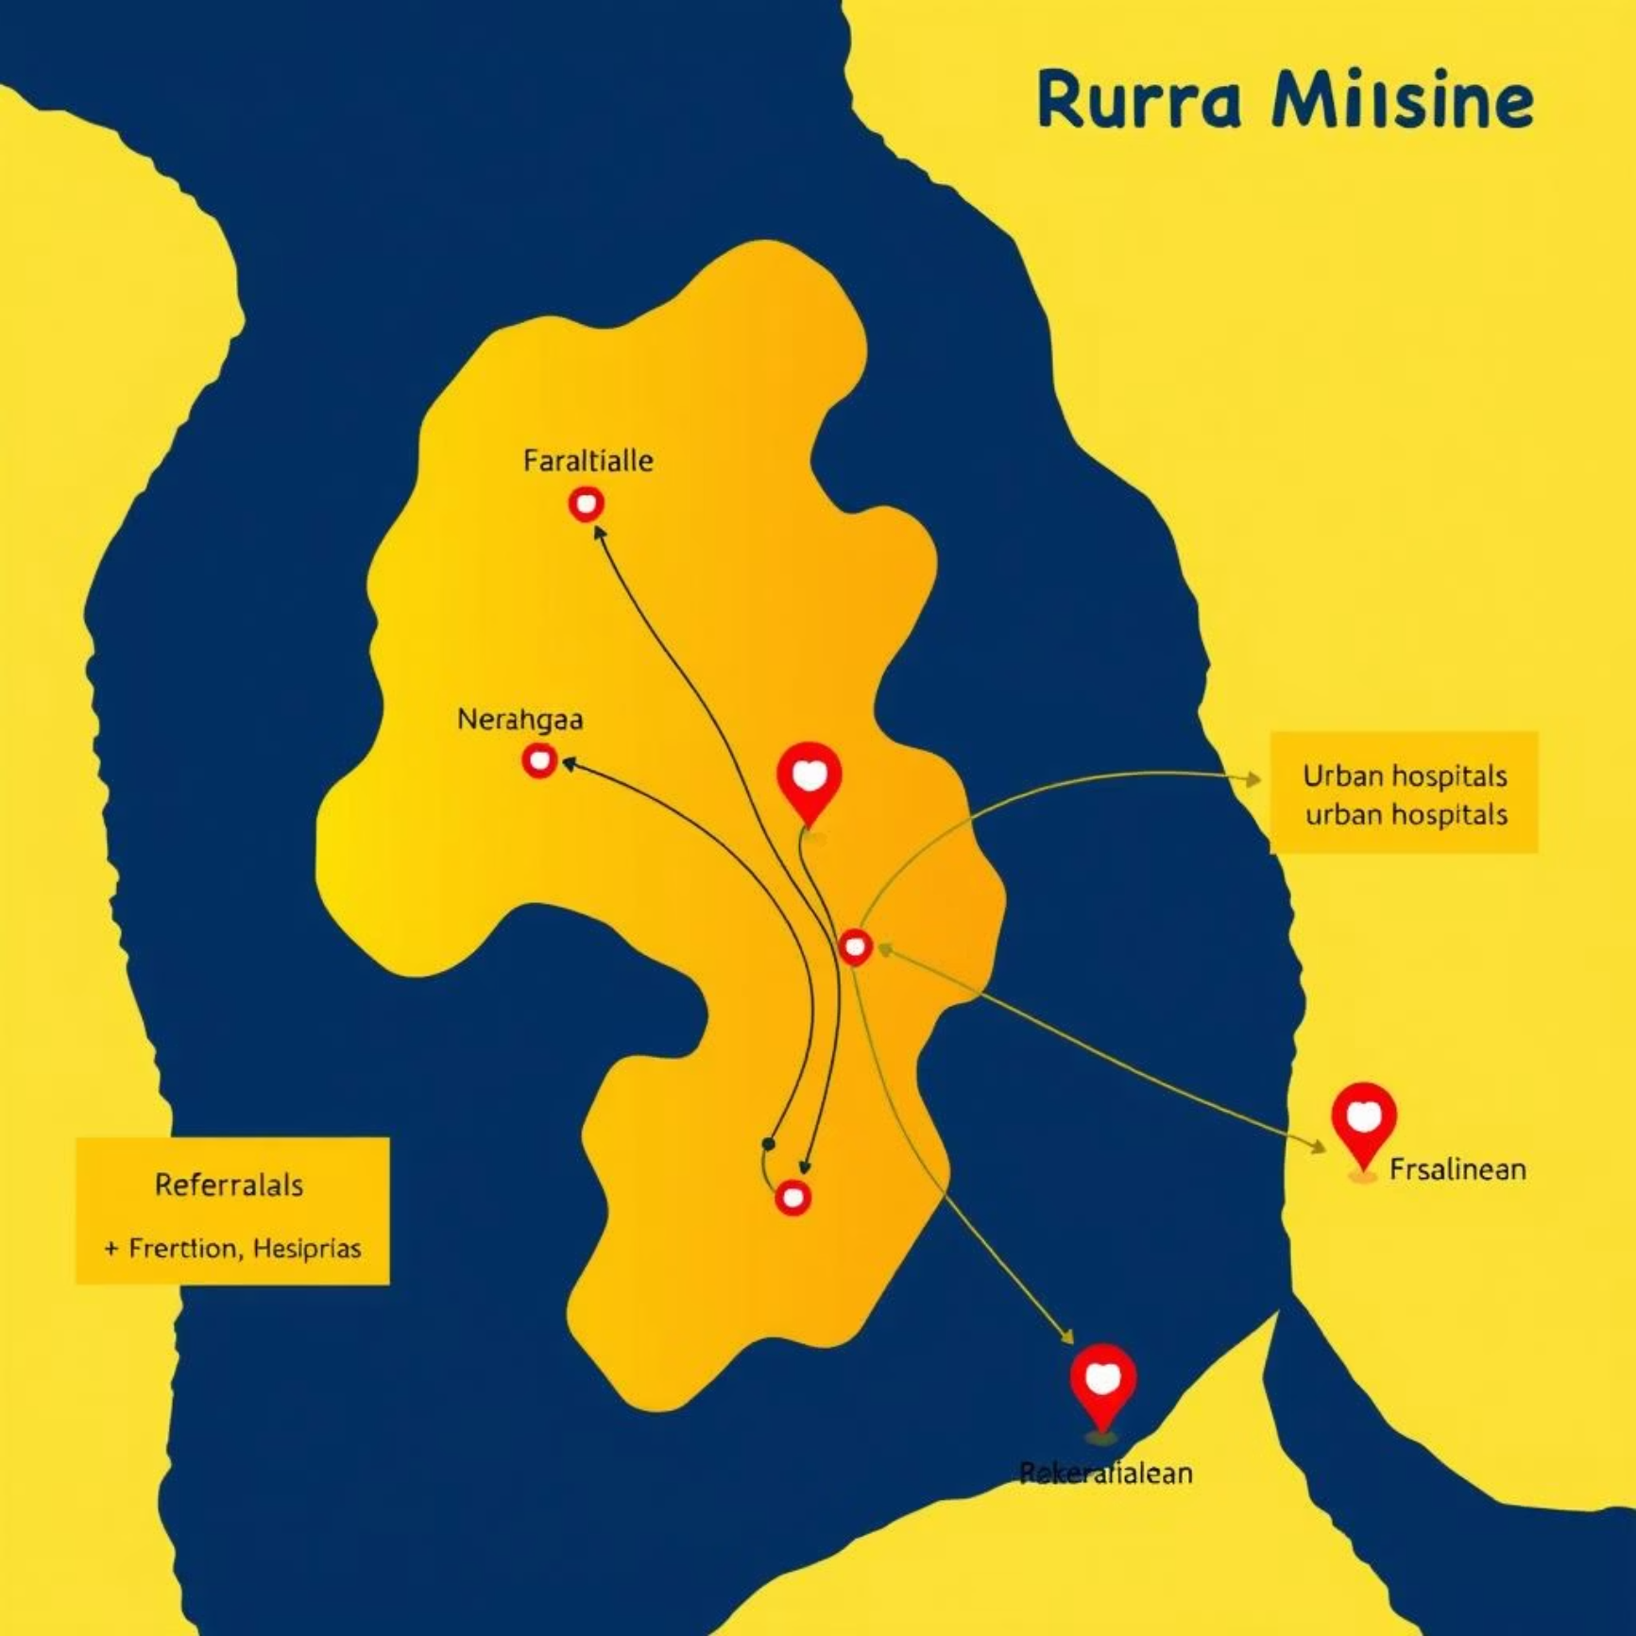
Integration of Referral Mechanisms for Specialized Medical Care
A crucial feature of the
platform is its ability to
provide referrals to
qualified medical
practitioners in nearby
urban centers. Based on
the preliminary diagnosis,
the chatbot will suggest
appropriate specialists or
clinics, along with their
contact information and
location.
This mechanism ensures that users receive timely and appropriate specialized medical care when needed, bridging the gap between rural patients and urban healthcare facilities.

Slide 8

Accessible via Basic Mobile Devices for Broad Reach
To achieve broad reach and impact,
the AI-powered diagnostic chatbot
will be accessible via basic mobile
devices. This includes feature
phones, which are widely used in
rural areas, ensuring that the
platform is not limited to
smartphone users.
The design will prioritize low data consumption and compatibility with older mobile operating systems, making healthcare information available to a larger population segment.

Slide 9
Identify the Problem
The primary problem addressed by this project is the limited access to timely and quality healthcare in rural areas. This limitation leads to delayed diagnoses, inadequate medical interventions, and poorer health outcomes for rural populations.
In rural areas, timely healthcare access is limited, impacting the quality of medical interventions.
The lack of medical infrastructure, scarcity of qualified practitioners, and geographical barriers contribute significantly to this challenge.

Slide 10
Identify the Stakeholders
Rural Residents
Medical Practitioners
The primary beneficiaries who will use the chatbot for preliminary health assessments and referrals.
Doctors and specialists in urban centers who will receive referrals and provide advanced care.
Healthcare Organizations
Technology Developers
Government and non-government bodies involved in public health initiatives and policy-making.
The team responsible for designing, developing, and maintaining the AI chatbot platform.

Slide 11




Challenges Faced by Key Stakeholders
Rural Residents
Medical Practitioners
Limited access to healthcare, delayed diagnoses due to remoteness, high travel costs, and language barriers often prevent timely medical interventions and lead to poorer health outcomes.
Overburdened by patient volume from vast geographical areas, lack of detailed patient history or pre-screened information, and the challenge of managing follow-up care for remote patients.
Healthcare Organizations
Technology Developers
Difficulty in collecting accurate health data for policy formulation, inefficient resource allocation, and the challenge of effectively reaching and providing services to scattered rural populations.
Ensuring the chatbot's accessibility on basic mobile devices, achieving high AI diagnostic accuracy in diverse cases, maintaining data privacy, and scaling the platform to serve a large, varied user base.

Slide 12
Key Performance Indicators
To measure the success and impact of the AI-powered diagnostic chatbot, we will track specific Key Performance Indicators (KPIs) focused on reach, effectiveness, and user satisfaction.
500K
90%
75%
4.5/5
Active Users
Diagnostic Accuracy
Referral Completion
User Satisfaction
Targeting half a million active users within the first year of operation in rural India.
Aiming for 90% accuracy in preliminary diagnoses for common health conditions.
Ensuring 75% of referred patients successfully complete their follow-up specialist visits.
Maintaining an average user satisfaction rating of 4.5 out of 5 based on feedback.

Slide 13
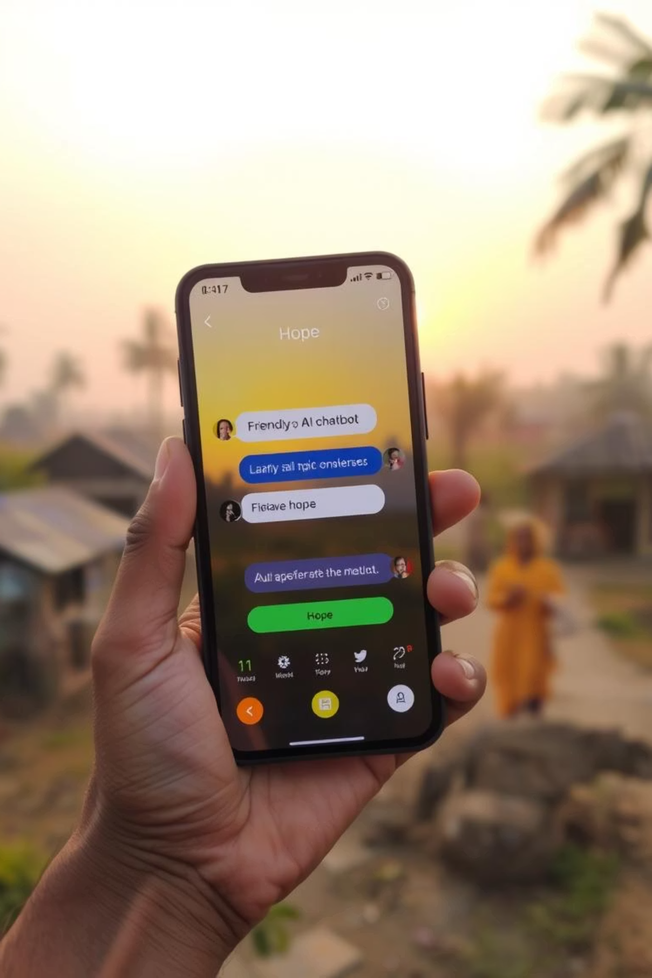
Envisioning a Healthier Rural India
Our AI-powered diagnostic chatbot represents a pivotal step towards equitable healthcare access in rural India. By leveraging simple mobile technology and advanced AI, we empower communities with immediate, accurate health information and essential referrals.
This initiative promises to transform lives, foster healthier communities, and ensure no one is left behind in the pursuit of well-being.

